Slide 2
What ARE THE GOALS THAT PEOPLE MAKE AT NEW YEARS TYPICALLY CALLED?

Slide 5
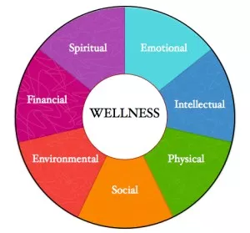

Slide 6
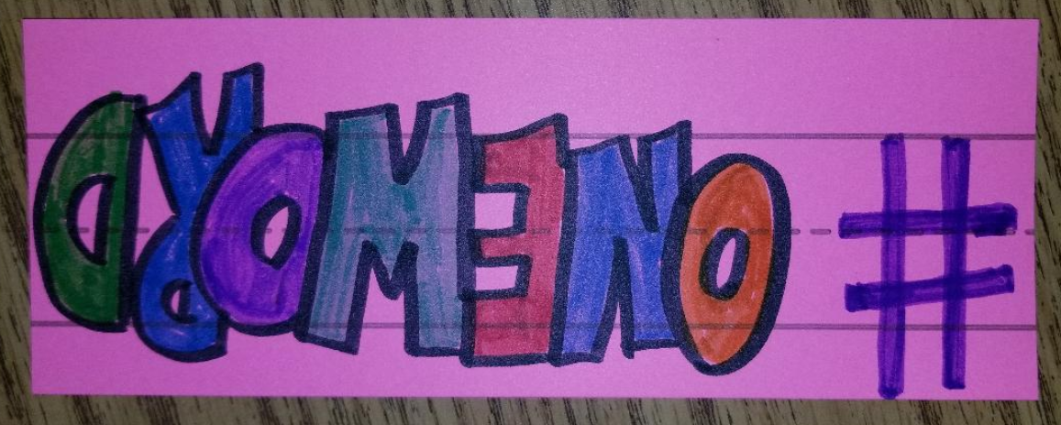

Slide 8
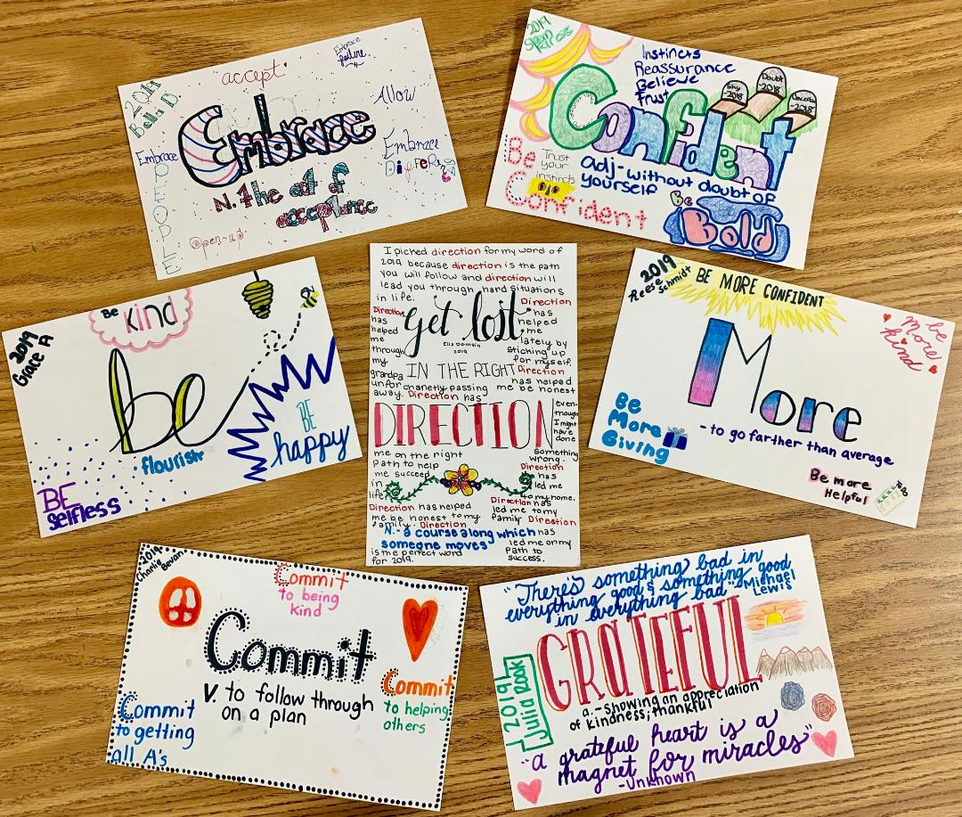

Slide 9
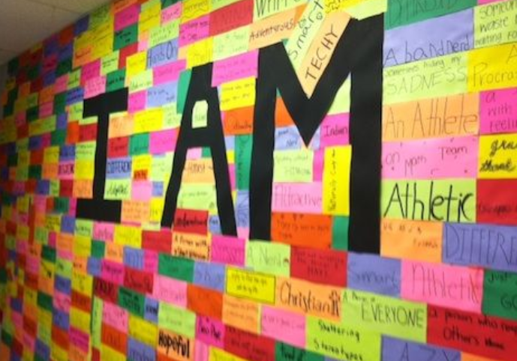

Slide 10
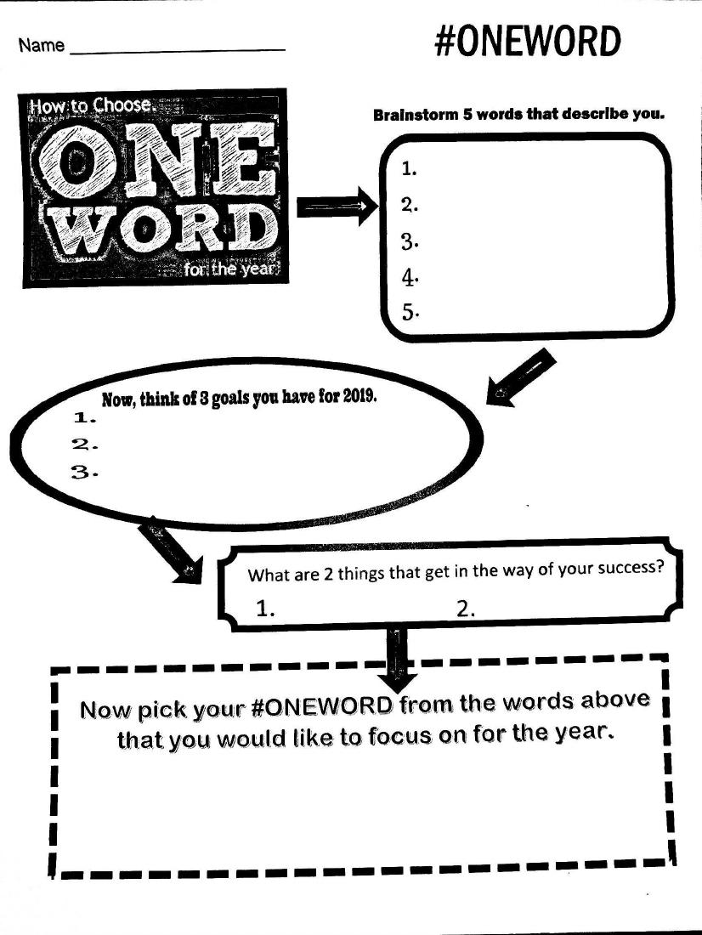

Slide 11
