Slide 1


Slide 2

What ARE THE GOALS THAT PEOPLE MAKE AT NEW YEARS TYPICALLY CALLED?

Slide 3


Slide 4


Slide 5
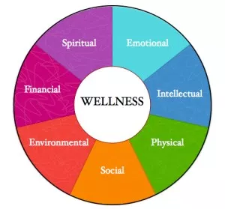

Slide 6
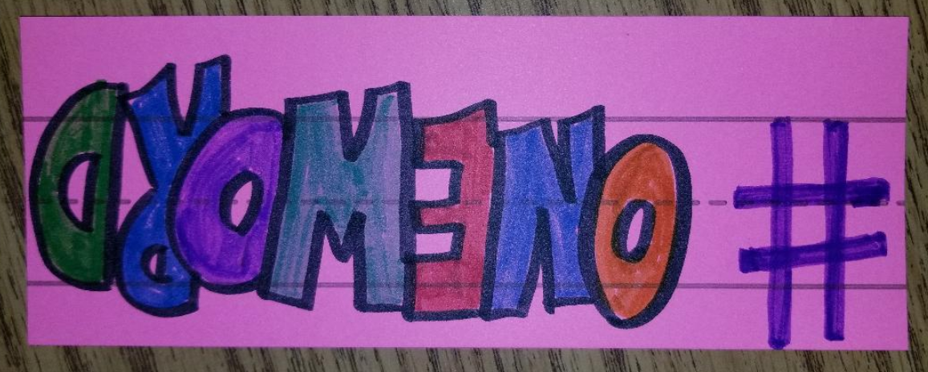

Slide 7



Slide 8


Slide 9
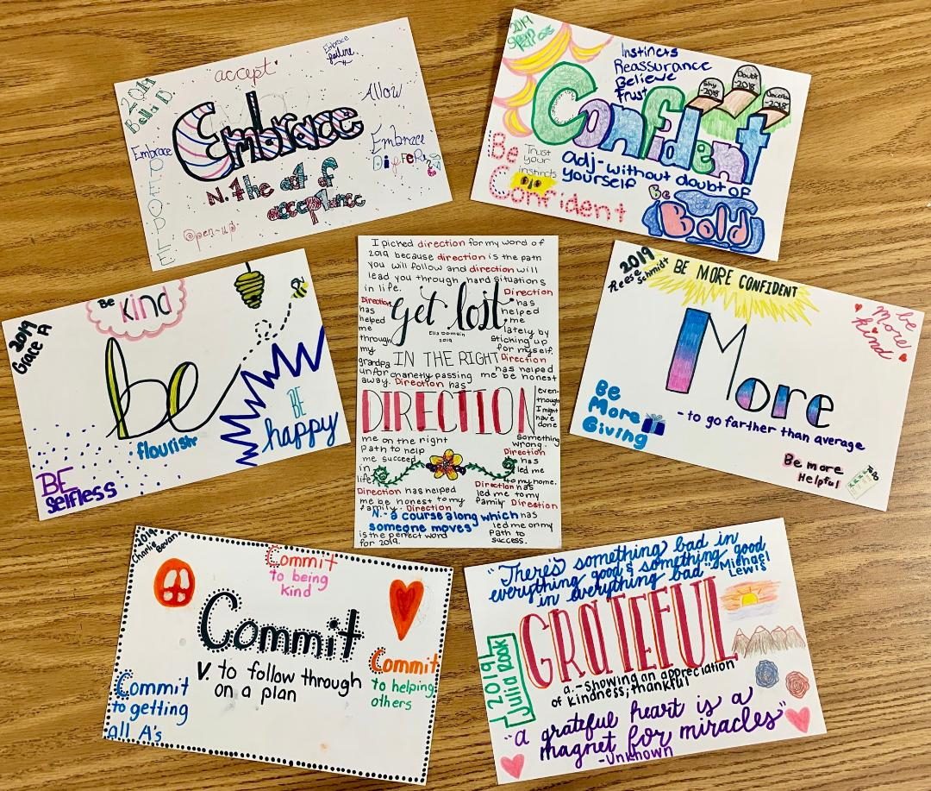

Slide 10


Slide 11
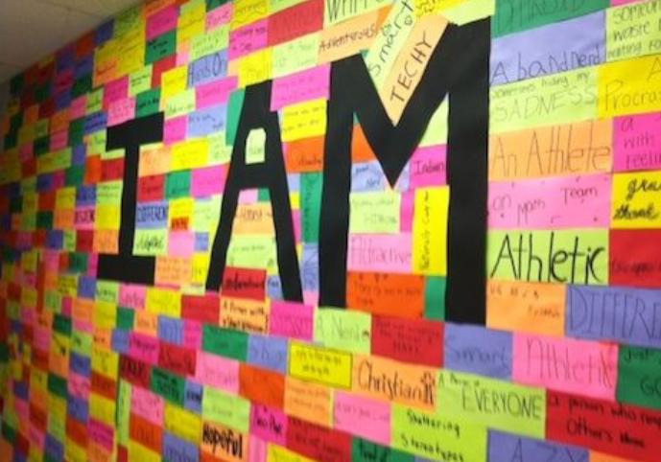

Slide 12

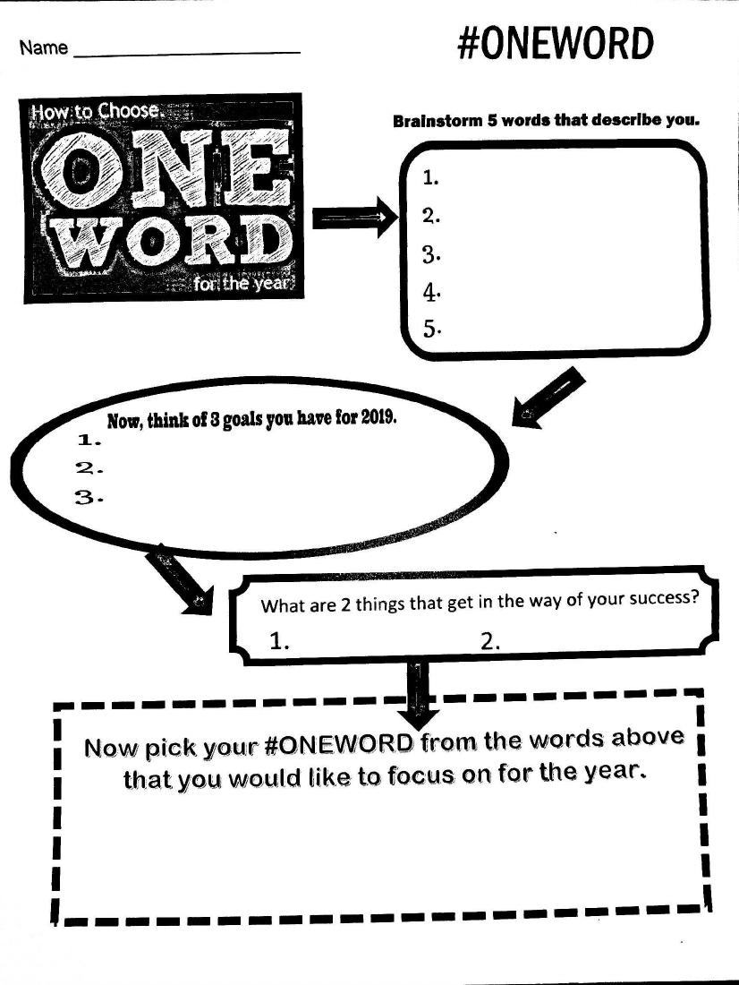

Slide 13
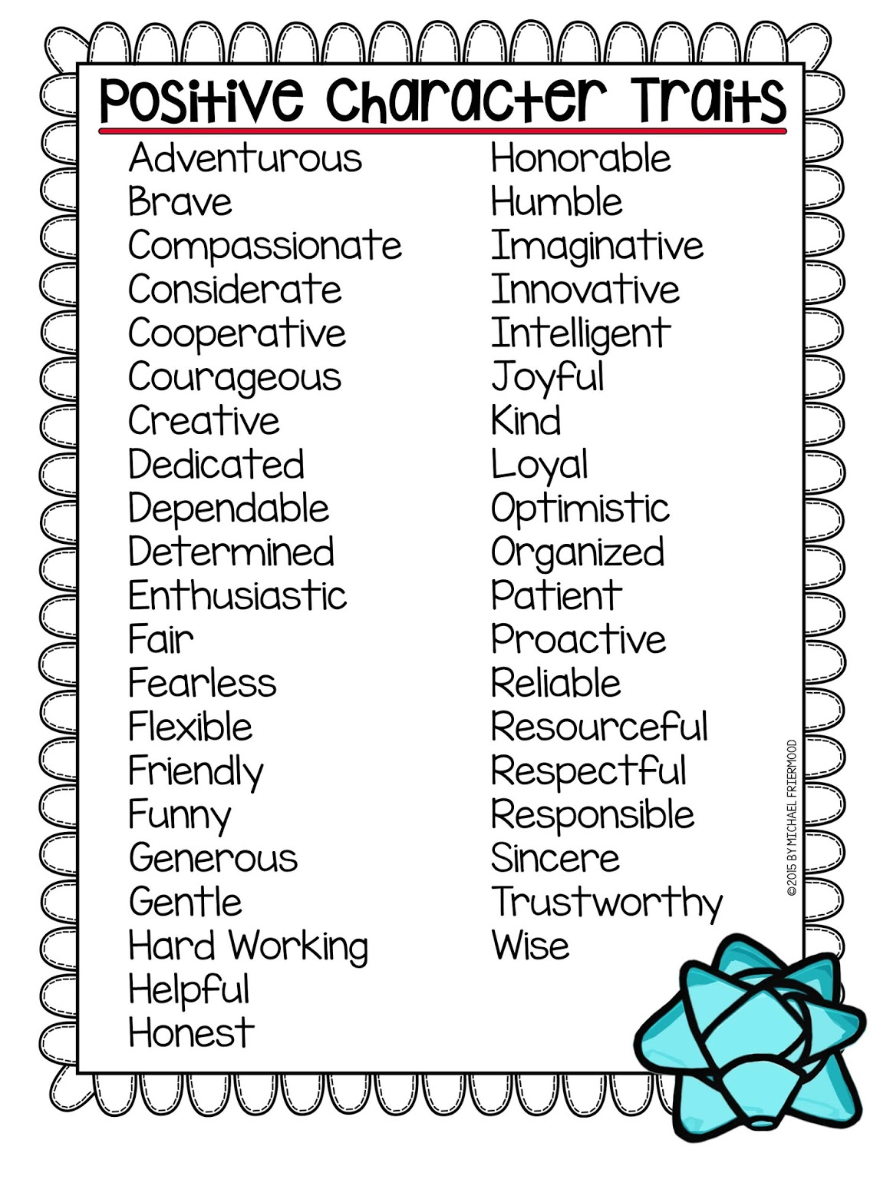


Slide 14
