Slide 1

WHEN YOU HAVE FREE TIME….
How can you
your brain?
(especially when you are bored?)

Slide 2


Read aloud video

Slide 3
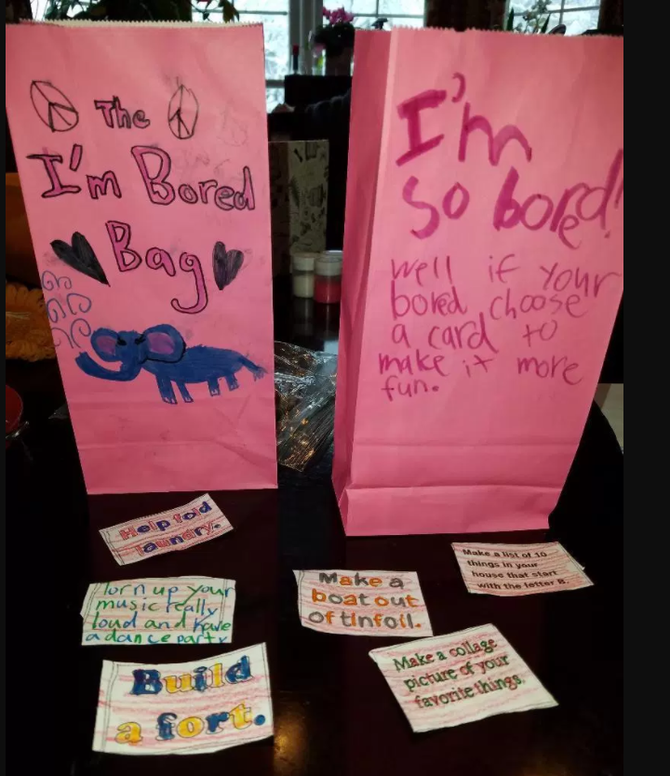

Slide 4
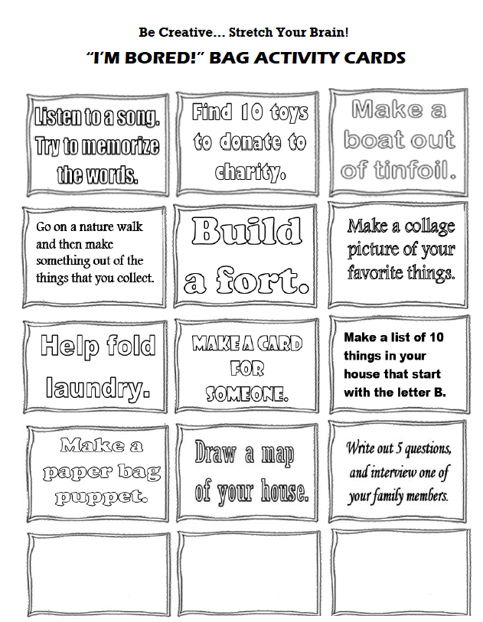
1.Color in cards.
2. Fill in 3 ideas of your own
3. Cut out cards.
4. Decorate your bag.

