Slide 1




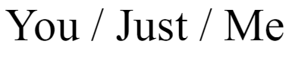
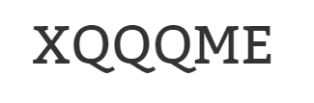

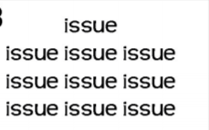

#1
#4
#5
#2
#6
#3
#7
If you don’t get it, just remember… you don’t get it YET

