Slide 1
GETTIN’ READY FOR MIDDLE SCHOoL
How to open a combination lock
QUESTIONS AND ANSWERS
SETtING GOALS FOR NEXT YEAR
Ms. KING
Classroom Core Lessons

Slide 2
What am I worried about ?
Figuring out what to wear | Going from being oldest to youngest students in the school. | Getting Lost in the Building | I won’t pass the 5th grade and might not make it to middle school!
Changing clothes for P.E. | It will be a LONG day (dismissal is at 4pm) | *Cyber Issues* (Internet, Twitter, Facebook, Texting Instagram) | Bullies
I’ll forget my locker combination | Getting to class on time | PEER PRESSURE | Dealing with too many teachers
Making New Friends | My locker will get stuck | No recess | Getting it ALL Done Including Homework

Slide 3



Objective:
Students will acquire the knowledge and skill of opening a combination lock as a part of their 6th grade transition preparation by gaining confidence, and saving them time and anxiety as they enter middle school.
Before lesson….
After lesson…

Slide 4
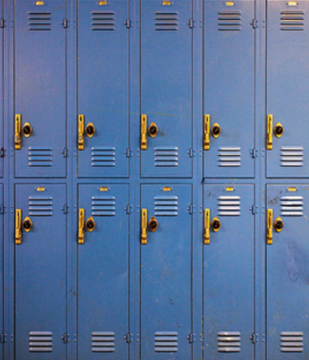

Demonstration
http://www.youtube.com/watch?v=gCs3DlsShWQ
https://www.youtube.com/watch?v=Kmx4WCAj77A

Slide 5


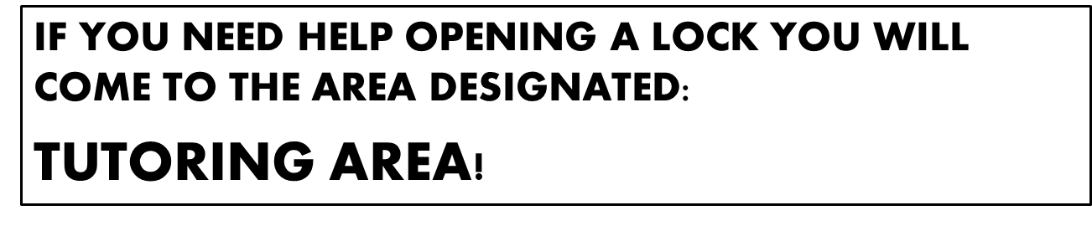
REVIEW… now you try!
Start at 0
Turn the dial 3xs to the right
Stop at your 1st number
Turn the dial 1 whole turn to the left
  (Passing the 1st number)
The 2nd time around stop at your 2nd number
Turn right Stop at 3rd number – Do not pass the 3rd number
Pull shackle to open

