Slide 1
What is Resilience?
On a scrap piece of paper write what you think this word means.

Slide 2
Now, crumble it up.
You can stand anywhere in the room to accomplish the goal
I am about to give you. The only rule is no talking.

Slide 3
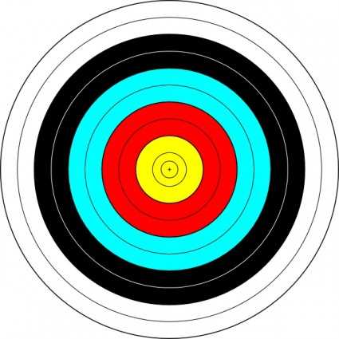
GOAL

Slide 4
This is a review of Growth Mindset.
Where you stood to throw your paper and
How you reacted if you did or didn’t accomplish
your goal tells me about your mindset.

Slide 5
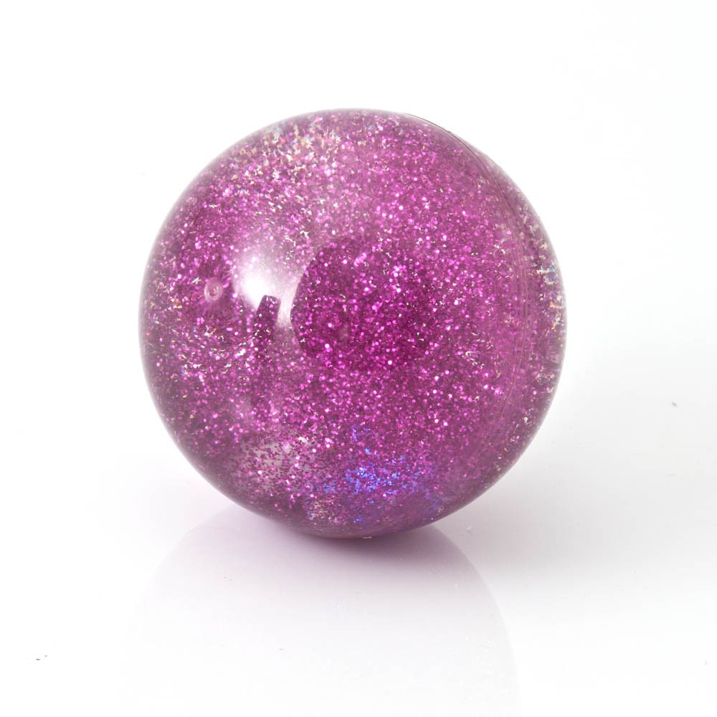
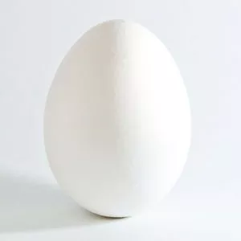
Which one are you?
To have GRIT you must bounce back

Slide 6
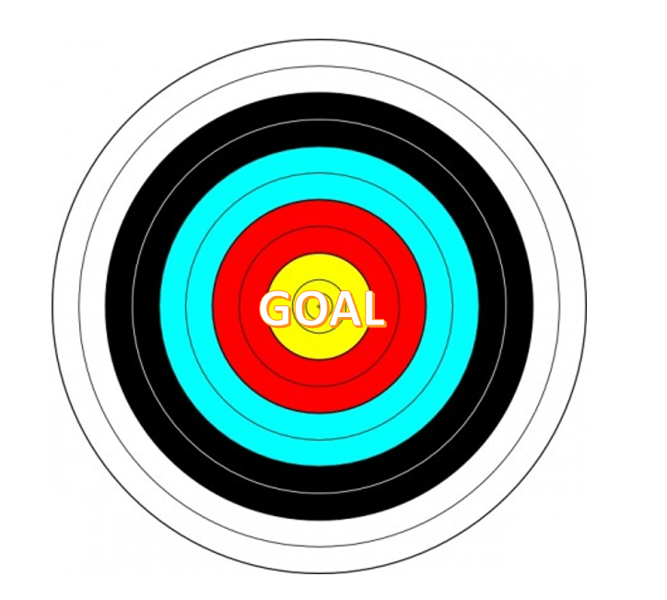
I need 2 volunteers.

Slide 7
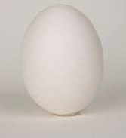
Which one are you?
To have GRIT you must bounce back

Slide 8
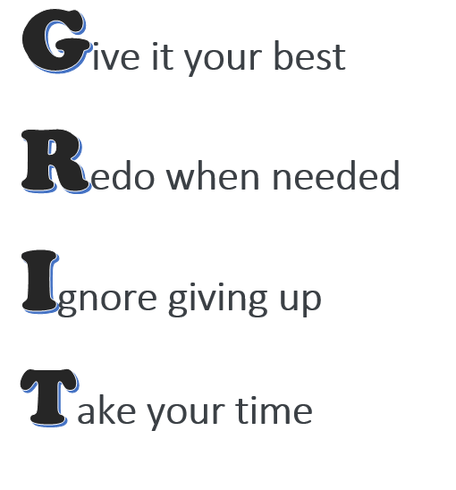
Who remember what GRIT is?
Keep trying!

Slide 9
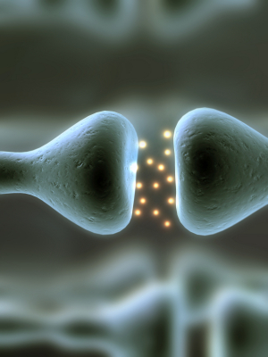

Slide 10
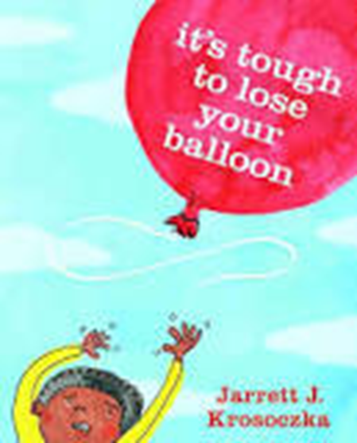

Slide 12
True or False?
1. I know a lot about how the brain works.
2. I am interested in how the brain works.
3. People that are smart at math and reading will get better careers when they are older.
4. Your brain actually grows the more you practice different skills.
5. When kids know about how their brain works, they actually do better in school.
6. When you take a deep breath, your belly goes in.

