Slide 1
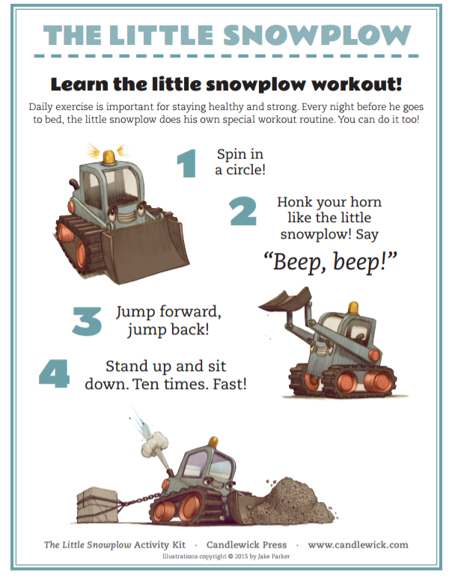

Click here to hear a song about snowplows

