Slide 1
Exploring Feelings

Slide 2
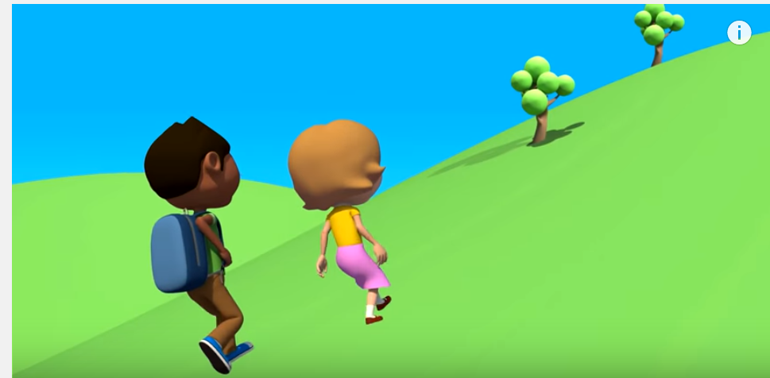
Have you heard the story about Jack and Jill?

Slide 3
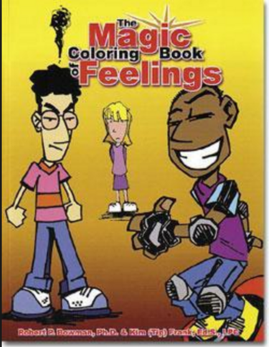
Feelings are powerful!!

Slide 4
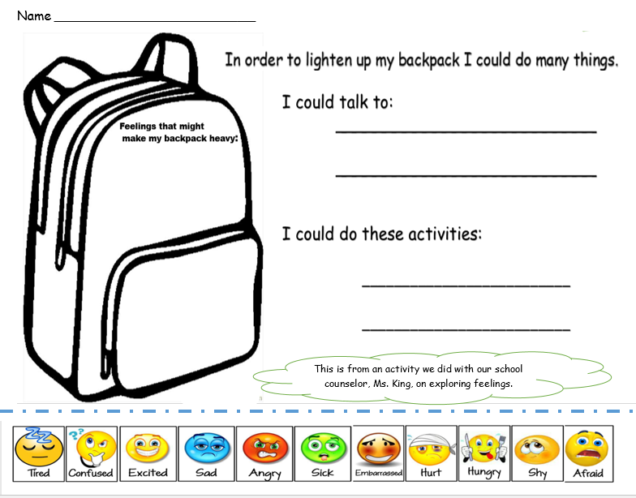

Slide 5
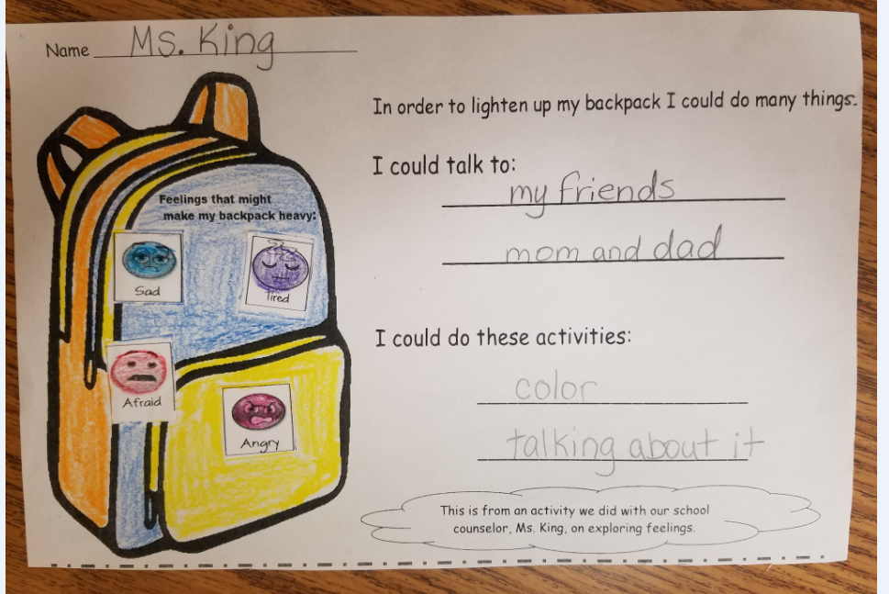
my teacher
grandma
Ms. King
brother
Sister
aunt or uncle
play
dance
watch TV
take a nap
run
take a deep breath

