Slide 1
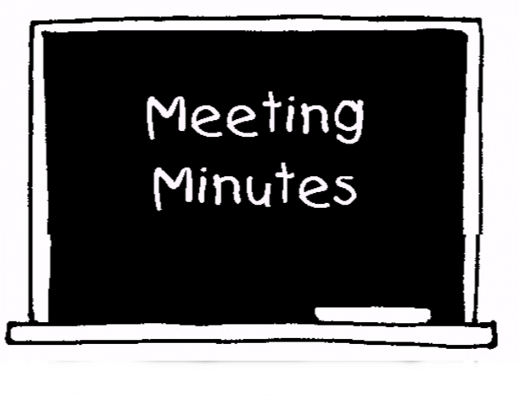
How will this work?

Slide 2
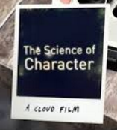
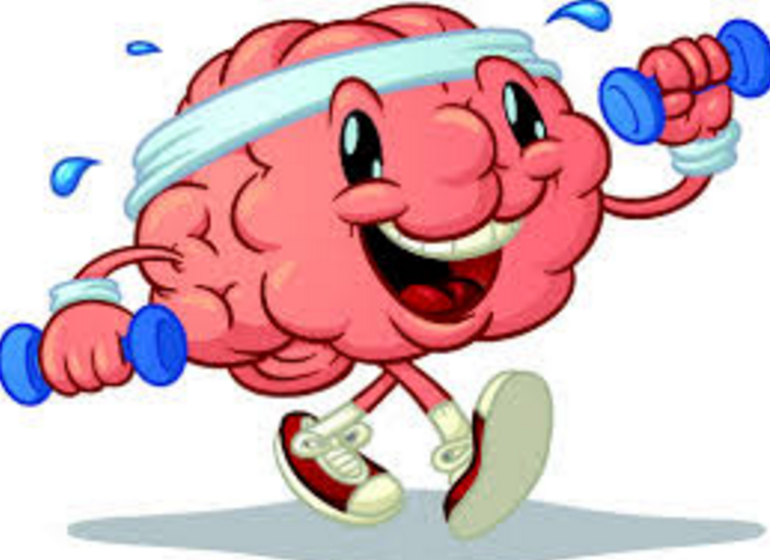
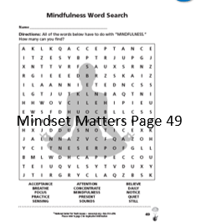
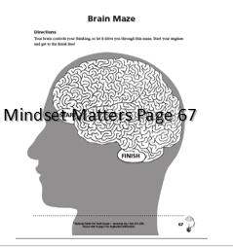
While I am in the hallway with one student at a time…
You will be watching 2 videos.
(Pay attention! You will need to write down a few things you learned!)
You will have these worksheets to work on until everyone has had their minute meeting.

Slide 3
The Science of Character
https://www.youtube.com/watch?v=U3nT2KDAGOc
The Learning Brain
https://www.youtube.com/watch?v=cgLYkV689s4

