Slide 1

SAFETY !
What are some safety rules you know ?
In this lesson we will review more about:
Stranger Danger
The Uh-Oh Feeling
Knowing your Address & Phone #
Internet Safety

Slide 2
What is a STRANGER?
A “stranger” is someone you do not know.

Slide 3
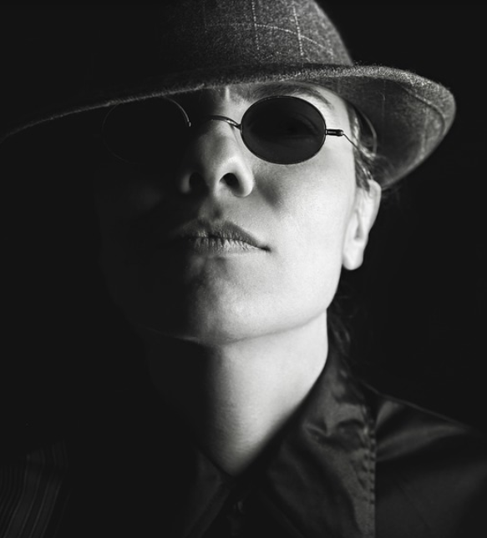
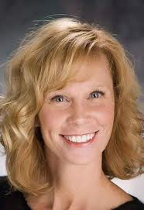
What DOES A STRANGER look like?

Slide 4



Slide 5
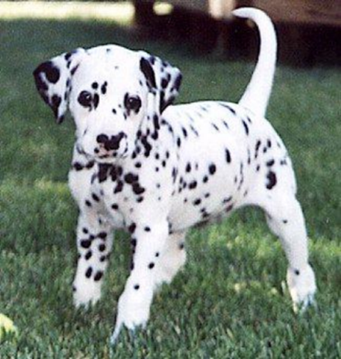
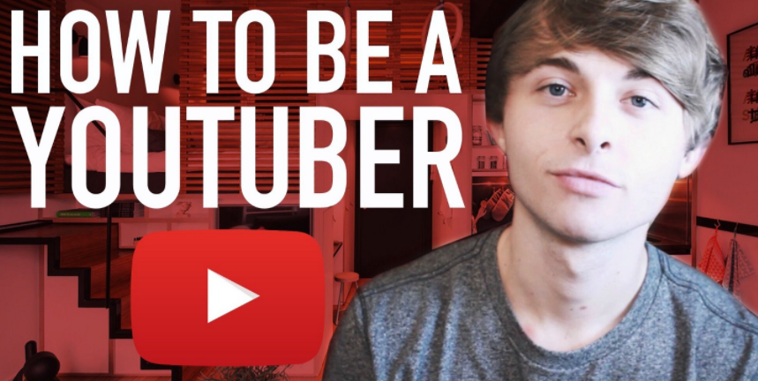
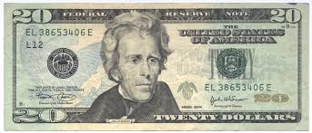
You should NEVER go with a stranger no matter what they say.
Have you seen my dog?
I can make you famous!
Cana you help me? I’ll pay you $20.

Slide 6
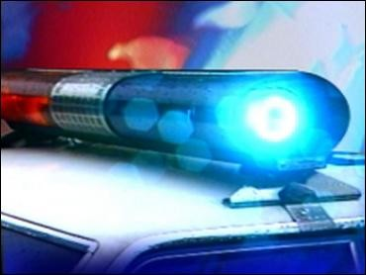
Trust your inner “siren” & any “UH-OH” feelings you have.

Slide 7

Let’s Watch THIS VIDEO to Review…
With this short video
https://www.youtube.com/watch?v=fEtJtFEVDbI

Slide 8
SAY NO!
It is OK to say NO to a grown up who is breaking a safety rule!!!
Say it loud!

Slide 9

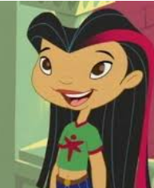
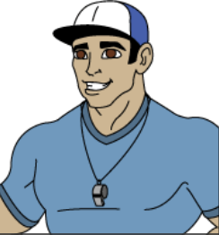

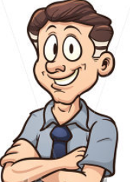
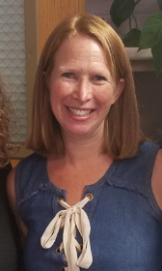
Who are some trusted adults you could talk to about safety situations?

Slide 10

Trust Your Feelings
FOR STRANGERS
+
PEOPLE YOU KNOW TOO!

Slide 11
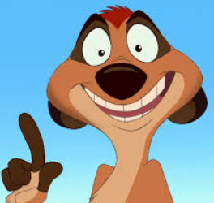

ONE MORE THING…
LET’s REVIEW
SOME INTERNET SAFETY!
Another important safety tip!
https://www.youtube.com/watch?v=M-njh8mFvVk&nohtml5=False

Slide 12
If you have a safety ISSUE, What Information should you know?
Your name and street address.
Your grown-ups’ phone numbers.

