Slide 1

SAFETY !
What are some safety rules you know ?

Slide 2
What is a STRANGER?
A “stranger” is someone you do not know.

Slide 3
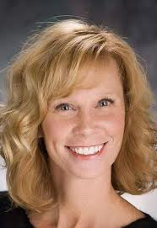

What DO they look like then?

Slide 4



Slide 5
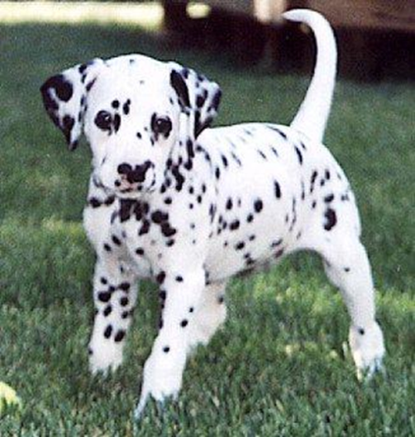
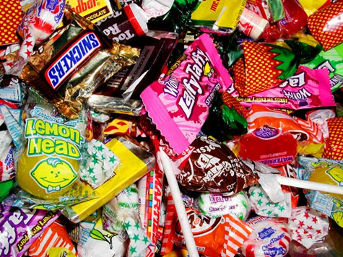
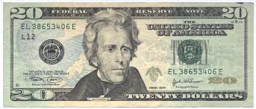
Sometimes, a stranger might ask you to go with him/her. You should NEVER go with a stranger no matter what they say.

Slide 6
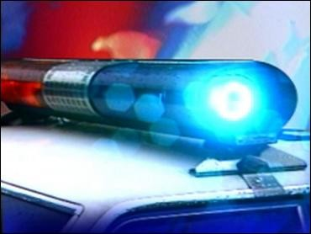
Trust your inner “siren” about any “UH-OH” feelings you have.

Slide 7

Let’s Watch to Review…
With this short video

Slide 8
SAY NO!
It is OK to say NO to a grown up who is breaking a safety rule!!!
Say it loud!

Slide 9
RUN
MAKE LOTS OF NOISE
RUN AWAY FAST
FIND A SAFE ADULT

Slide 10

Who are some trusted adults you could talk to about safety situations?

Slide 11
What you SHOULD know...
1. Your name, address, and phone number
2. Your parent’s names and work phone numbers
3. What number you call in an emergency
WHEN CALLING...
911

Slide 12

Trust Your Feelings
FOR STRANGERS
+
PEOPLE YOU KNOW TOO!

Slide 13

Before we end this lesson, we need to go over
Another important safety tip!

