Slide 1
Technology ideas for Counselors

Slide 2
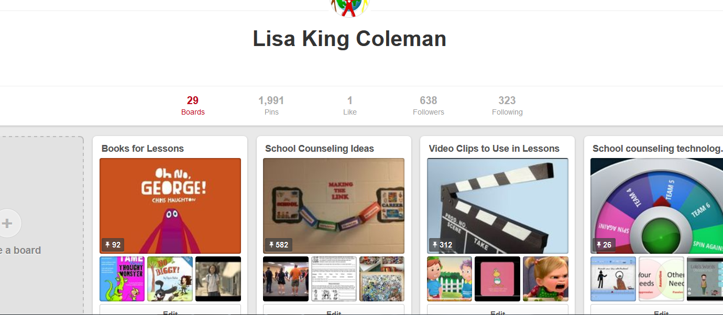
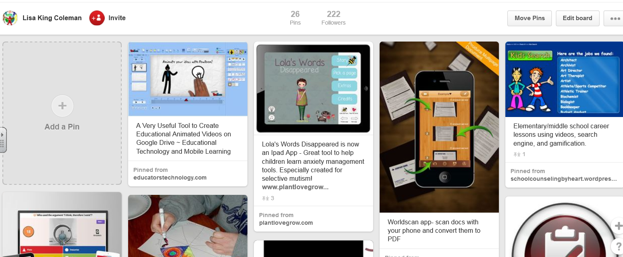
PINTEREST

Slide 3
Some Pinterest Tips
Search by term for pin and for board
Search for all pins and for MY Pins

Slide 4
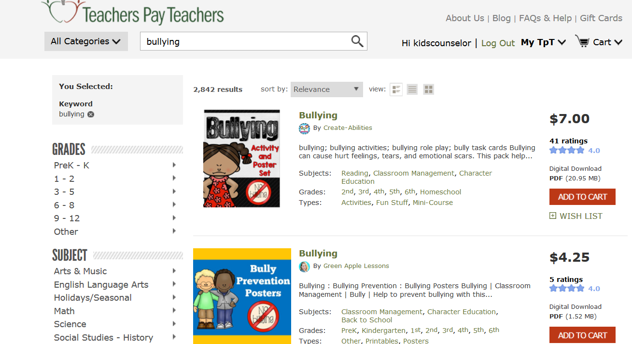
Teachers Pay Teachers

Slide 5
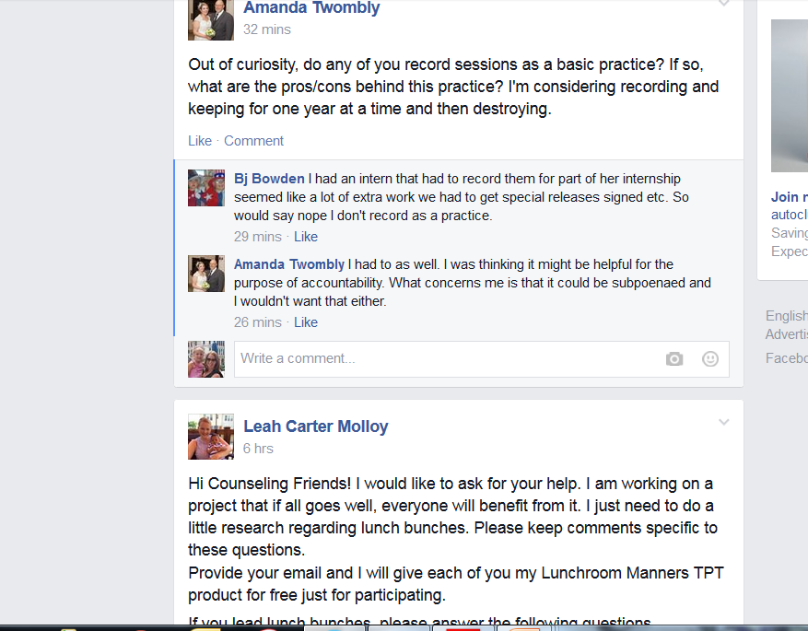
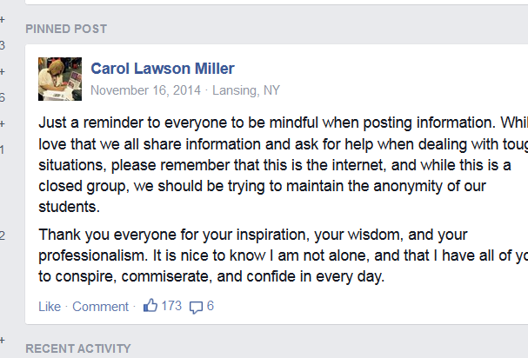
Facebook Pages

Slide 6
In progress
Look for the NEW ideas post for some of the resources I have discussed

Slide 8
Some helpful tips:
Snipping tool
Telegami

