Slide 1
IDEAS FOR HANDLING BEHAVIOR

Slide 2
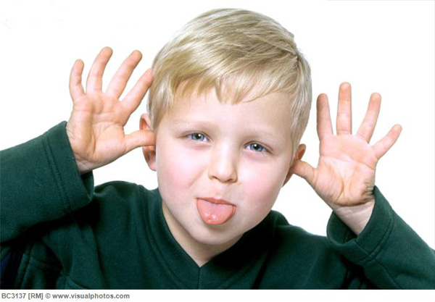
What not to do …

Slide 3
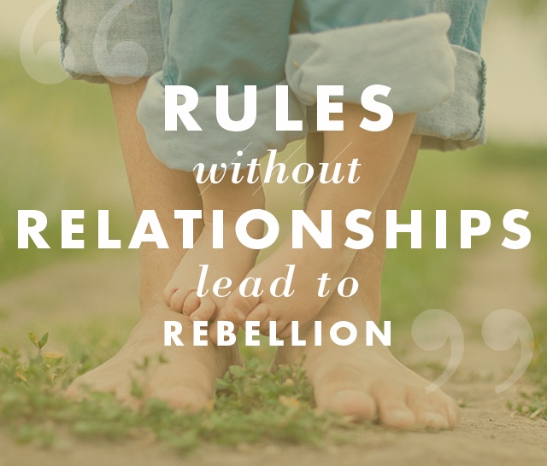

Slide 4
Introduce and/or remind your procedures. Some ideas are:
You decide to follow directions or choose to…
3 strikes and I’m out
Red tickets
Find out what the teacher’s system is.
Be consistent. (It’s why we have favorite restaurants… we know what to expect).
It doesn’t hurt to have prizes ( I mean positive reinforcement) Have them tie into what your lesson is.

Slide 5
Helping teachers with Behavior Management
For RTI, etc.
Links to Behavior Charts/Interventions
Intervention Central
http://www.interventioncentral.org/
Escambia County School District: Positive Behavior Interventions and Supports
http://www.escambia.k12.fl.us/pbis/data/
Behavior Downloads for Behavior Charts (elementary)
http://ayearofmanyfirsts.blogspot.com/2013/05/bravo-behavior-freebies.html
Free printable behavior charts
http://www.freeprintablebehaviorcharts.com/
PBIS World
http://www.pbisworld.com/
Behavior Charts at Worksheet Place.com
http://worksheetplace.com/index.php?function=DisplayCategory&showCategory=Y&links=1&id=31&link1=31

